Slide 1

SEIS 632-02 Data Analytics & Visualization
Career Pathway
Project By : Mugdha Dixit Pragya Verma
Kidist Wolde
Ramesh Babu Balaji

Slide 2
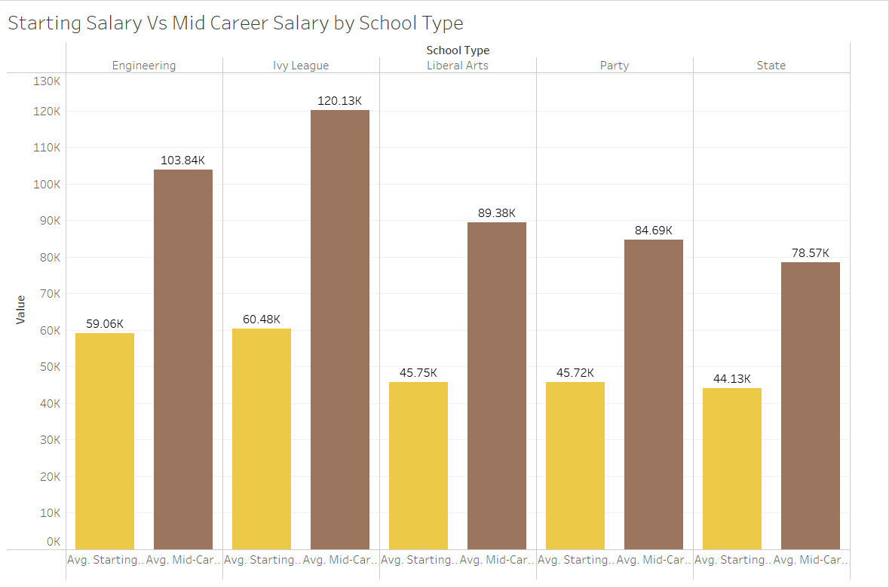
College Dataset
Region
California
Midwestern
Northeastern
Southern
Western
School Type
Engineering
Ivy League
Liberal Arts
Party
State
Major
Accounting
Aerospace Engineering
Agriculture
Anthropology
Anthropology
Art History
Biology
Business Management
Chemical Engineering
Chemistry
Civil Engineering
Communications
Computer Engineering
Computer Science
Construction
Criminal Justice
Drama
Economics
Education
Electrical Engineering
English
Film
PayScale Inc, conducted a survey of 1.2 million people with only bachelor’s degrees over the course of a year, and based on that we were provided a dataset to work on our final project.
We explored the dataset and found insights based on the given attributes below.
The college dataset has 3 csv files and salaries are based on the below attributes with the below observation.
Degree that payback
Salaries by College/school type - Salaries of some columns/percentiles were missing
Salaries by Region - Salaries of some columns/percentiles were missing
These datasets have below details:
Starting Median Salary
Mid-Career Median Salary
Mid-career 10th, 25th, 75th and 90th percentile salary

Slide 3
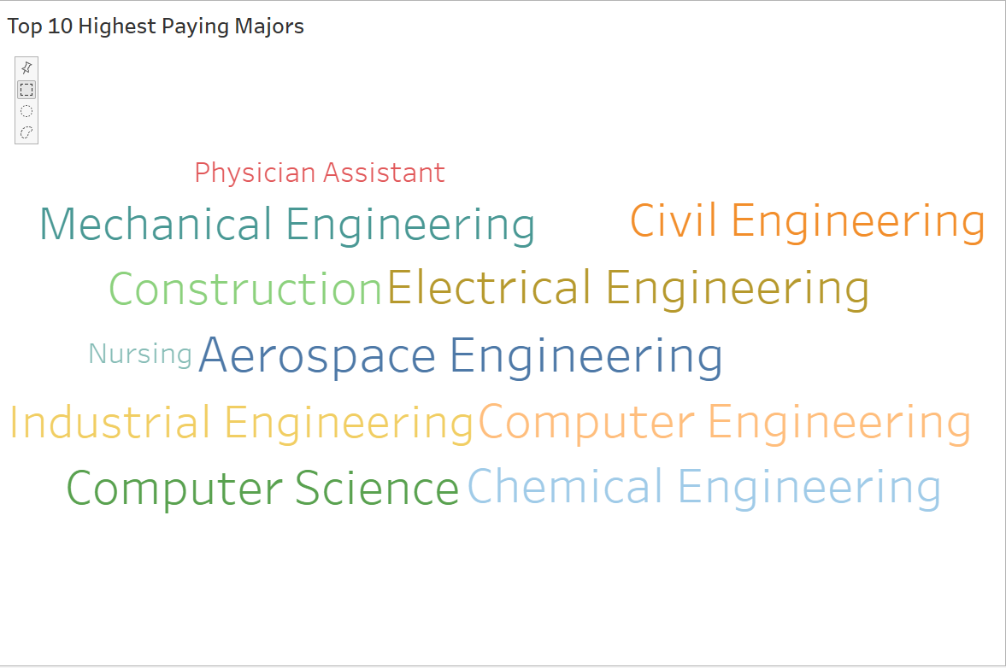
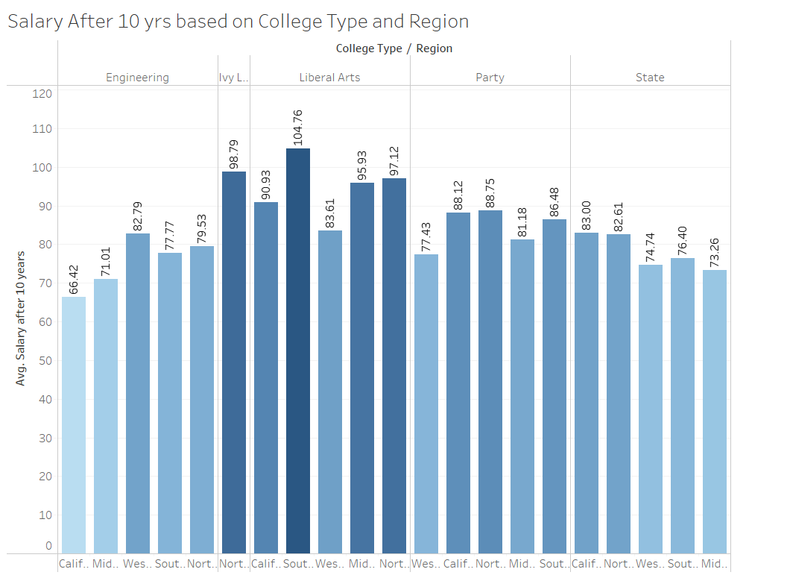
OVERVIEW
The project aims to focus on exploring how the type of college and region has an impact on salaries.
The project highlights the importance of choosing a college major that can lead to a high-paying career and provides guidance for students.
Overall, the project seeks to help users make informed decisions about their college education and career path and provides valuable information on the most lucrative majors and schools in the United States.

